Slide 1

ADAM
Research compilation on the reading of and advertising in professional and organization magazines
2021

Slide 2
Background

Slide 3
In April 2021, there were 107,430 registered associations in Finland.
In proportion to the population, this means that there are two associations for one hundred Finns.
Source: Finnish Patent and Registration Office, 30 April 2021 &
Population Statistics, Statistics Finland, 25 May 2021

Slide 4
54% of Finns over the age of 10 participate in the activities of an association.
The participation rate has remained roughly unchanged at the level of the general population since the early 1980s, but the participation rate of
10–14-year-olds and 65-year-olds has increased.
Source: Leisure participation, Statistics Finland, 2017

Slide 5
Men and women are equally active members of associations, but women are involved in more diverse activities.
Men are more involved in sports clubs and national defence organizations.
Women participate more than men in social and health care organizations, religious associations, cultural and art associations, agricultural and household advisory organizations, and school and kindergarten parents’ associations.
Source: Leisure participation, Statistics Finland, 2017

Slide 6
Participation in sports organizations or sports clubs is the most common form of association involvement
(24 %).
The next most popular is participation in the activities of a professional association (6%), a religious association (6%), a cultural or art association (3%) and a political party’s or adult organization’s activities (2%).
Source: Leisure participation, Statistics Finland, 2017

Slide 7
A person’s socioeconomic status affects their participation in association activities. Senior employees and entrepreneurs are most involved, while those who are unemployed are least involved.
Source: Leisure participation, Statistics Finland, 2017

Slide 8
Contents
01
About the study
05
Advertising
02
06
Readers’ background information
Reading
03
Readership
07
Summary
04
Researched articles

Slide 9
1.
About the study

Slide 10
20 professional and organization magazines were examined
12,152 respondents
The surveys were conducted between December 2020 and April 2021.
The research method was an online survey for readers of each magazine.
Implemented by JHelske Research
for Finnish Magazine Media Association (Aikakausmedia)

Slide 11
Magazines examined
Advokaatti (Finnish Bar Association's magazine)
Aivoitus (Brain Injury Association magazine)
Apteekkari (Finnish Association of Pharmacists magazine)
Betoni (construction industry trade magazine)
Caravan (caravan magazine)
Ekonomi (The Finnish Business School Graduates magazine)
Ihon aika (Psoriasis Union magazine)
Ilmailu (Finnish Aeronautical Association magazine)
Kemia (Finnish Chemical Magazine)
Koneviesti (professional magazine on agriculture, forestry and construction)
Lapsen Maailma (Children’s World, Journal of the Finnish Federation for Child Welfare)
Metsälehti (Most popular magazine for forest owners)
Opettaja (Most popular magazine for education professionals)
Pieni on Suurin (early childhood education magazine)
Pinni (professional magazine on hairstyling)
Hammaslääkäri (Finnish Dental Journal)
Taloustaito (The Taxpayers Association of Finland magazine, Finland’s most popular financial magazine)
Tehy-lehti (Union of Health and Social Care and Early Childhood Education and Care Professionals in Finland journal)
Uusiouutiset (Finnish Circular Economy News)
YTY (Union for private sector managers, professionals and senior salaried employees magazine)

Slide 12
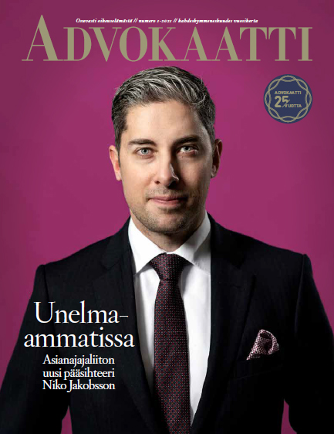
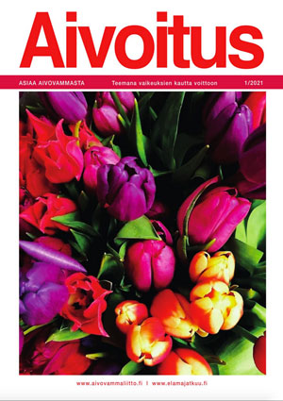
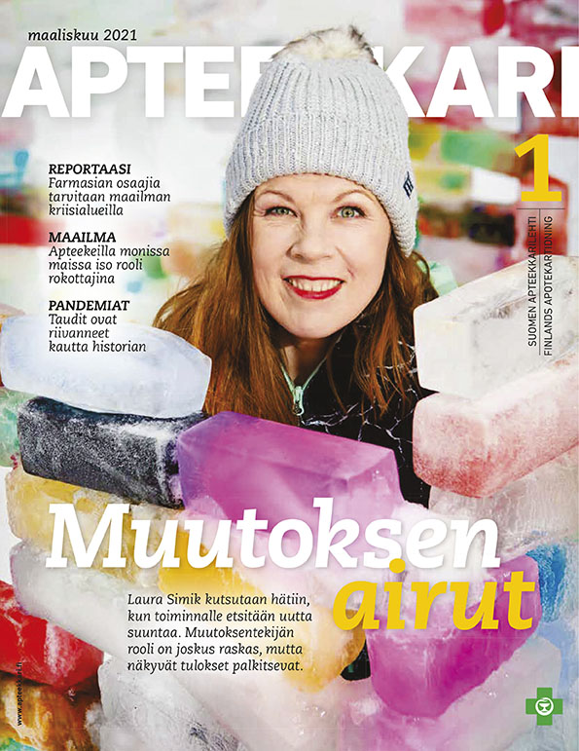

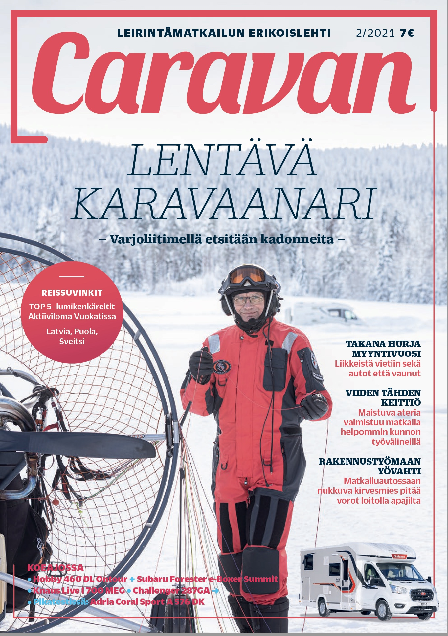

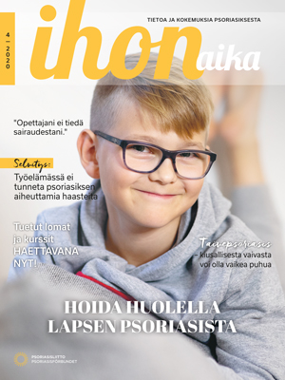
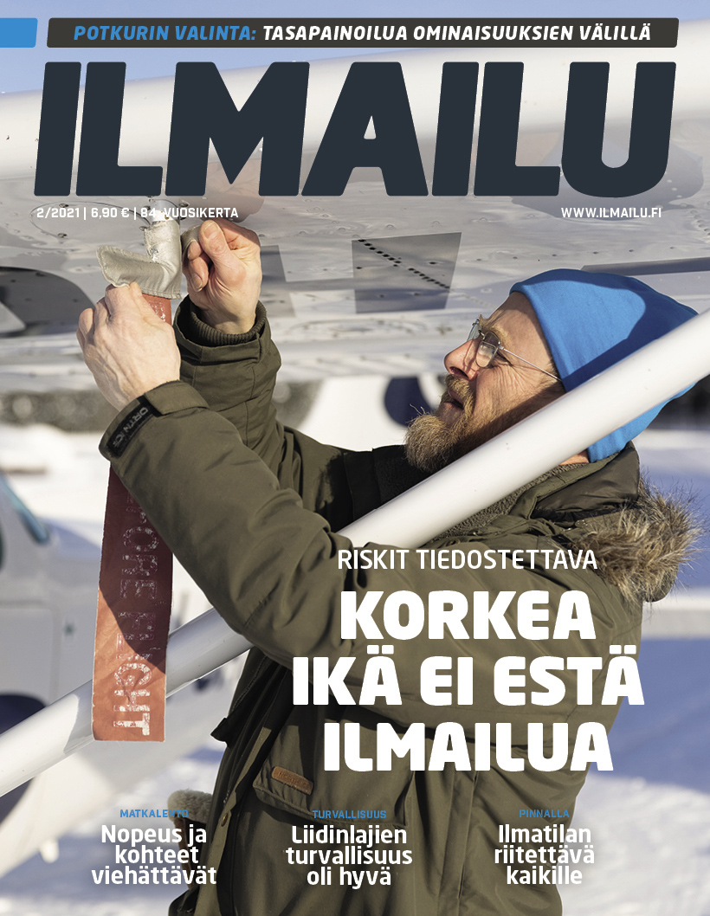
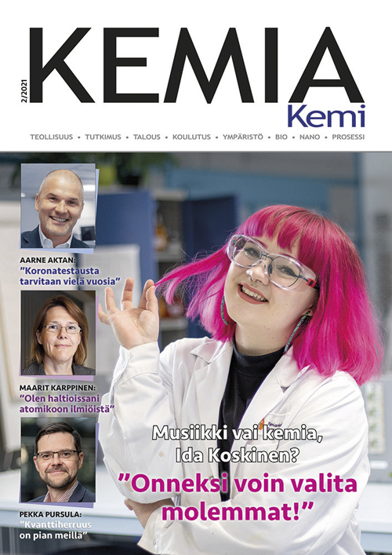
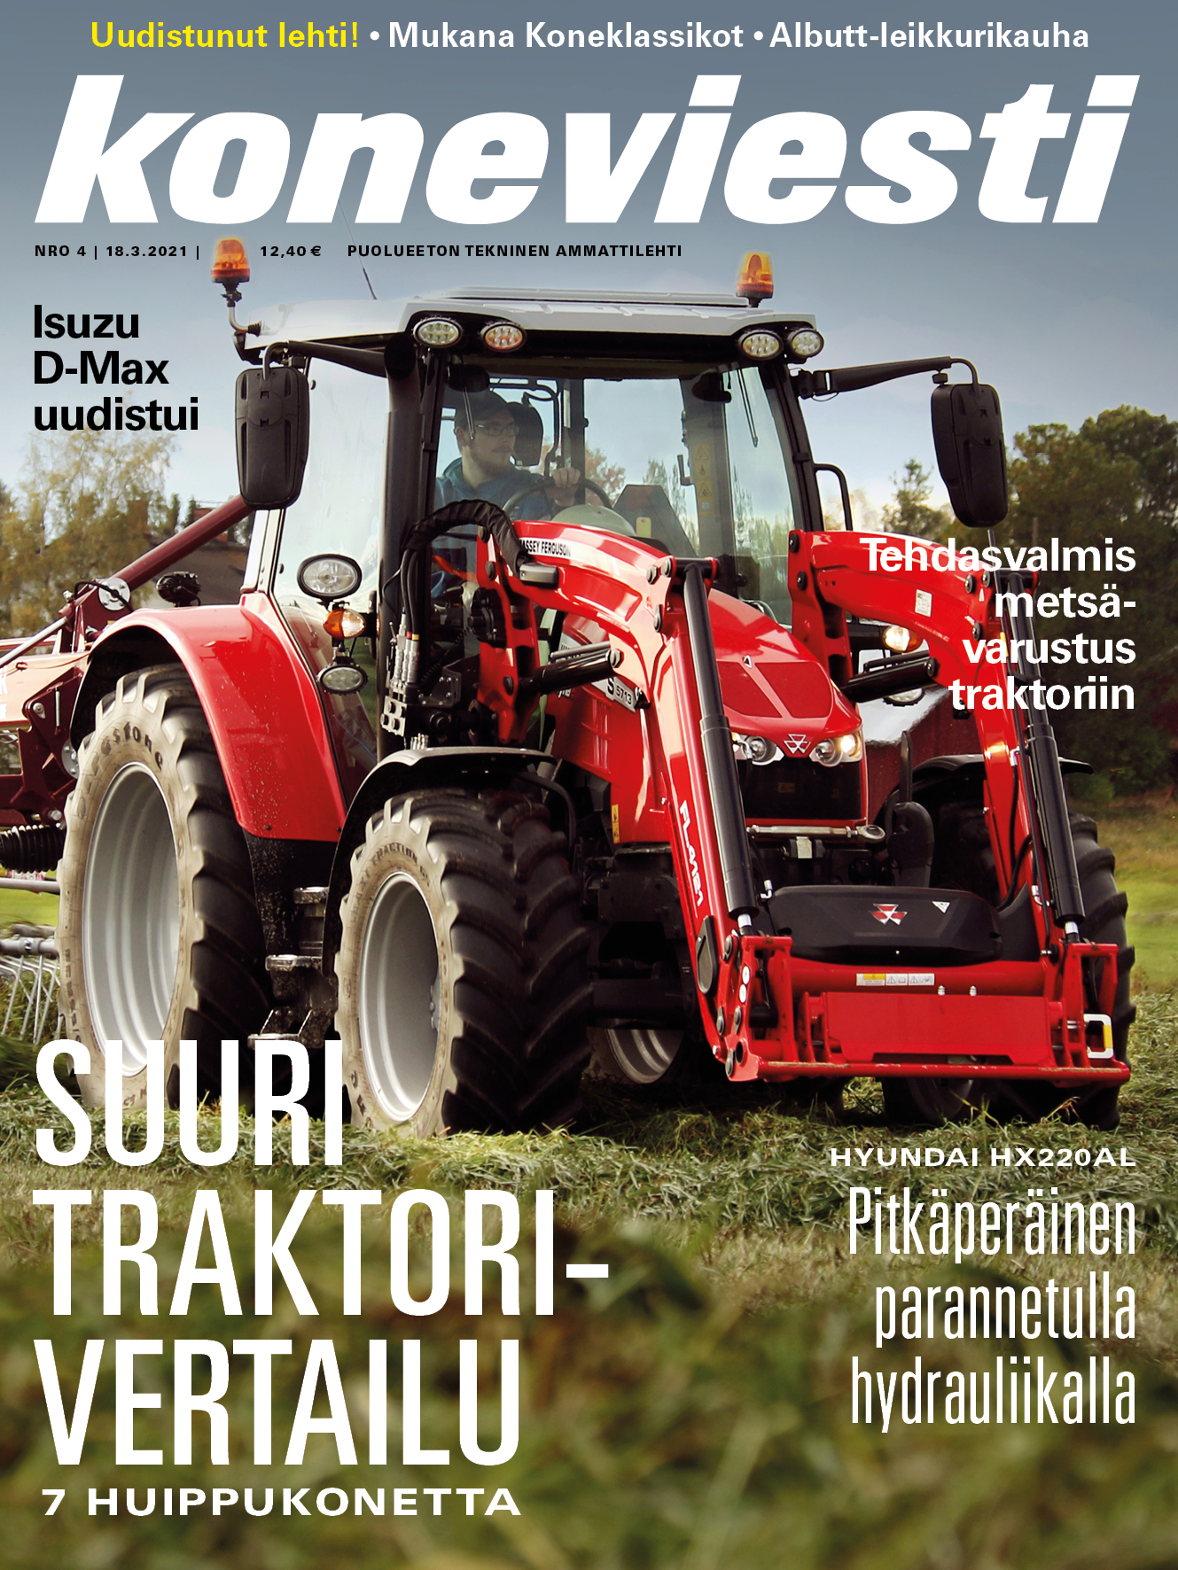

Slide 13
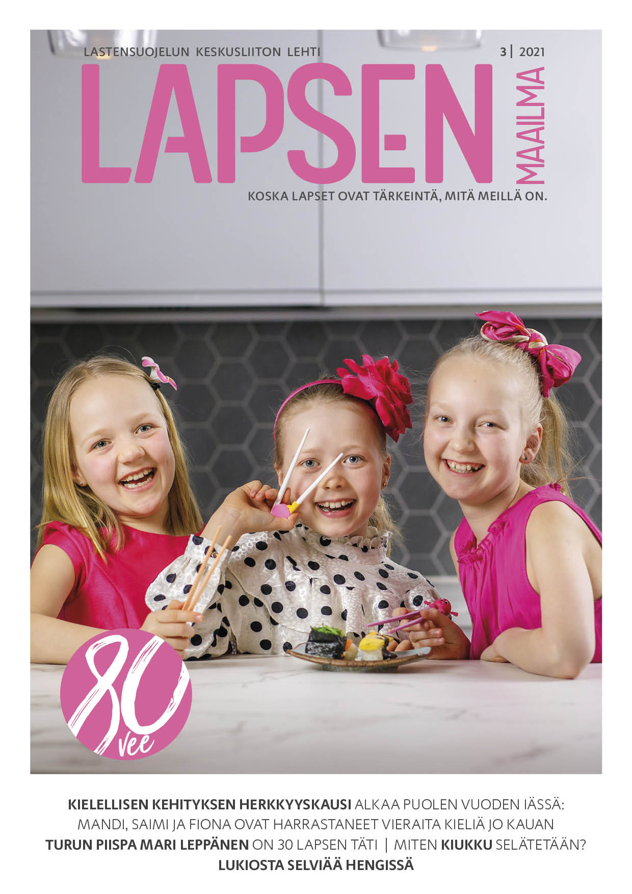
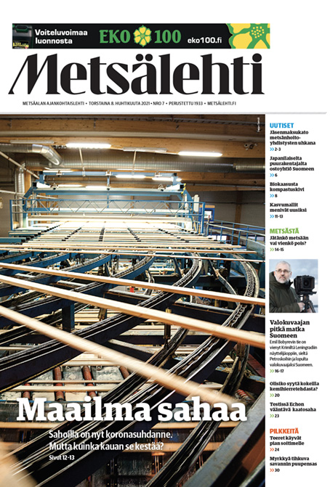
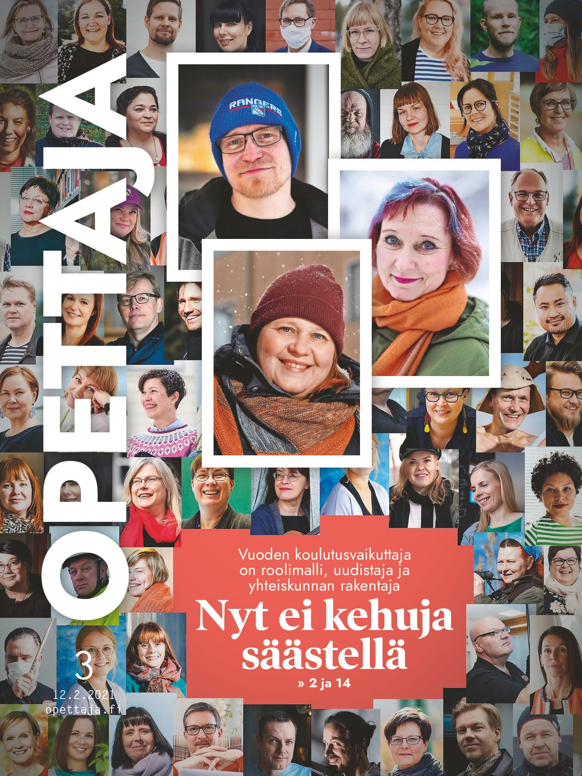
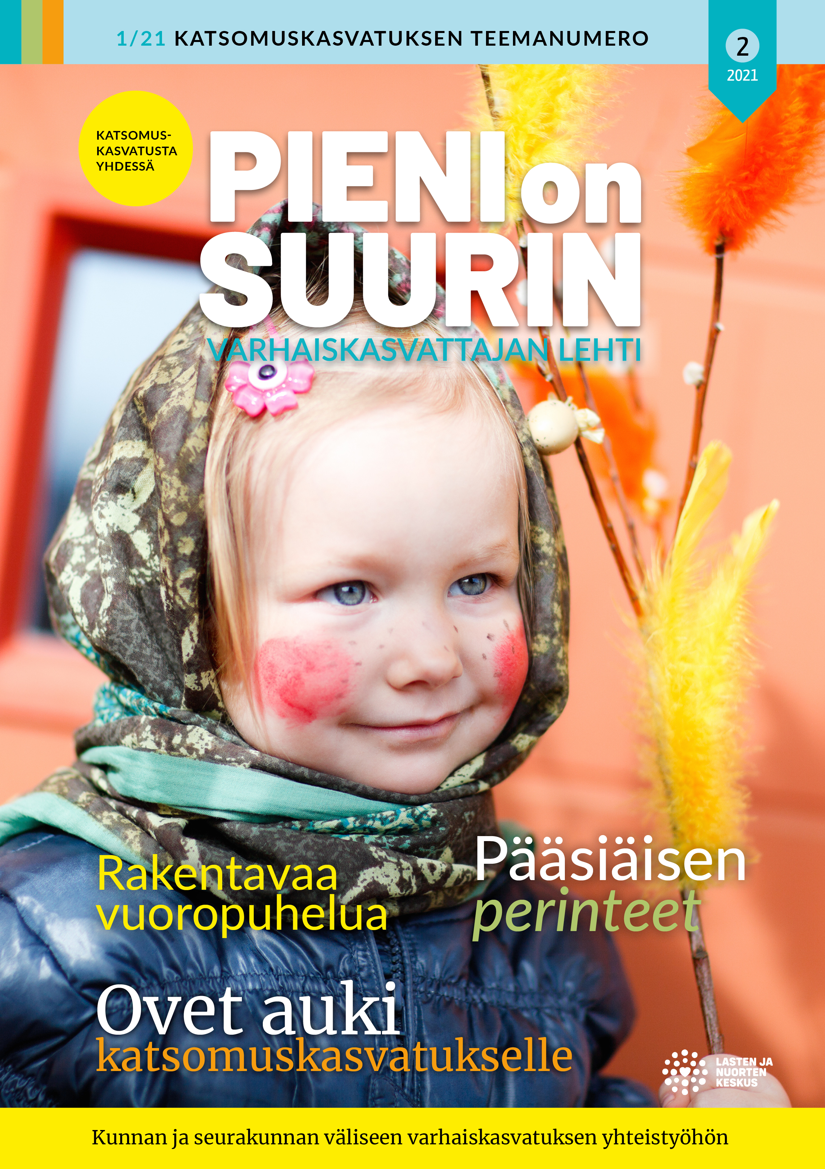

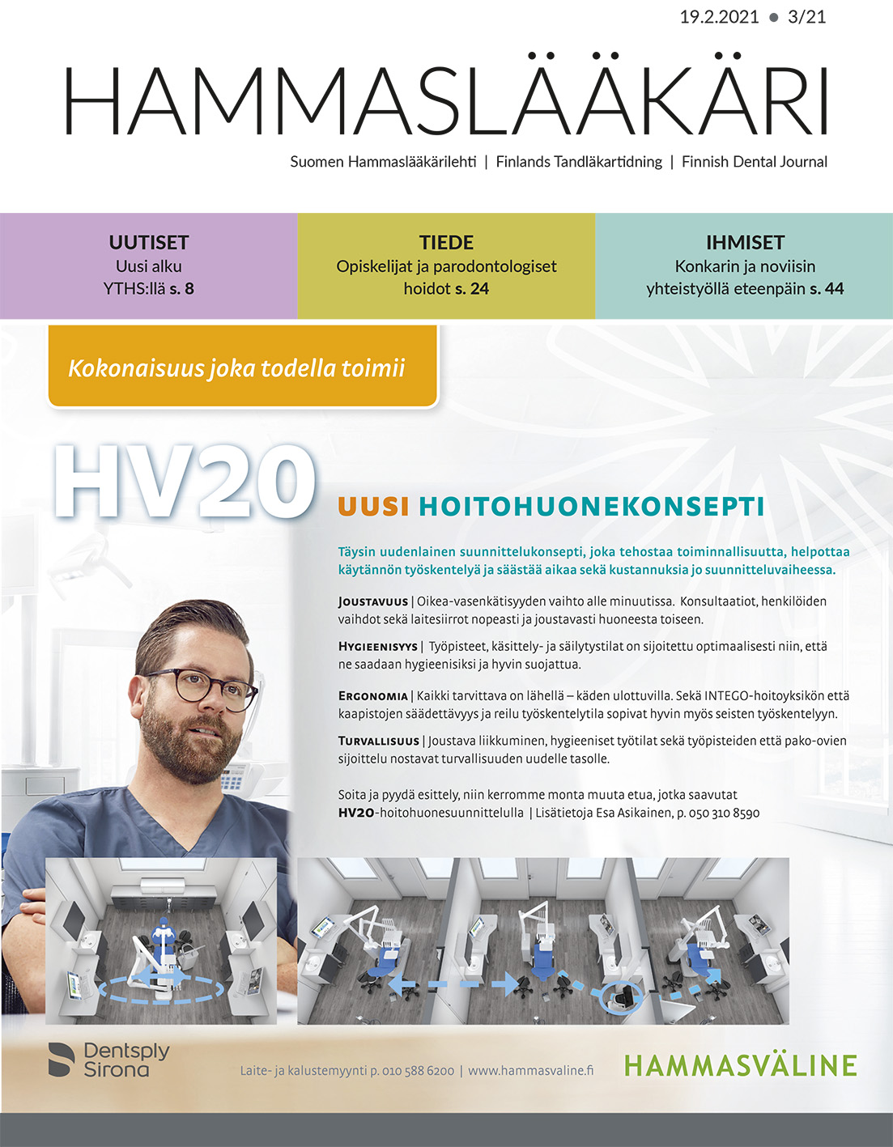
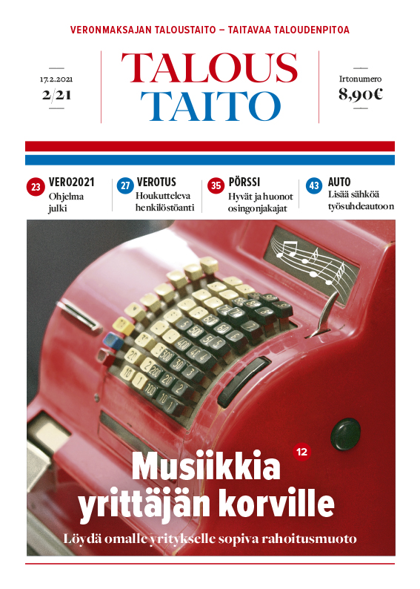
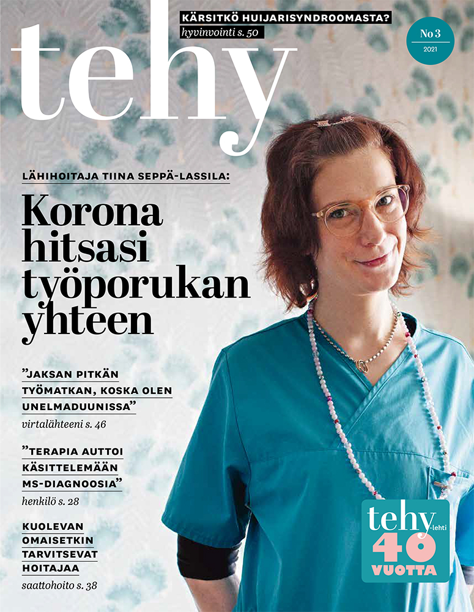
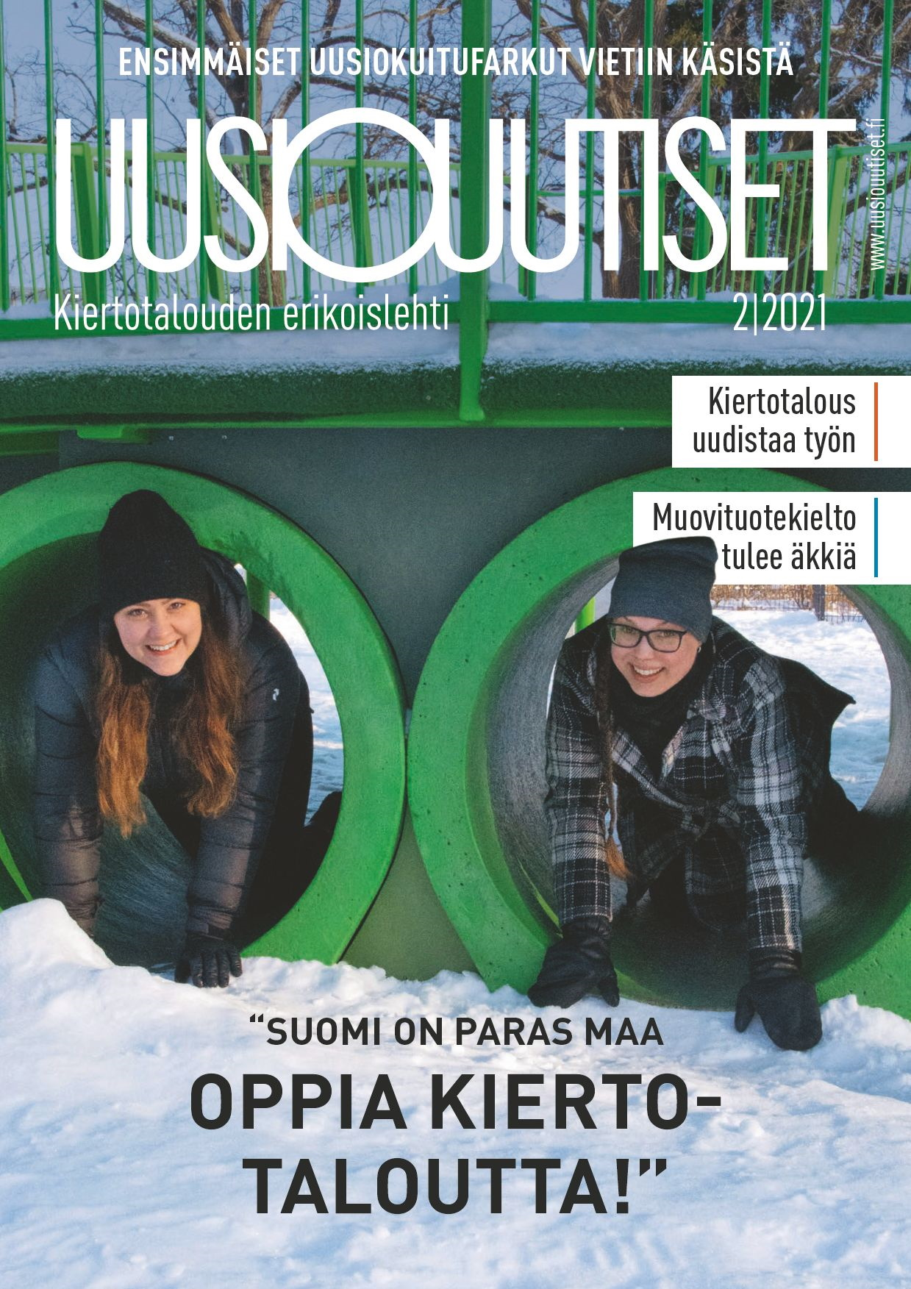
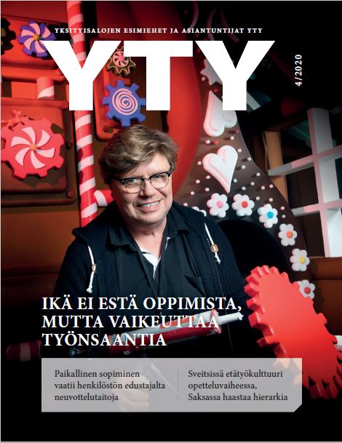

Slide 14
Readers of the examined professional and organization magazines are…
Professionals
such as lawyers, economists, dentists, circular economy professionals, forestry professionals, hairdressers, teachers, construction professionals, nurses and early childhood educators
Members of organizations and their stakeholders
Enthusiasts such as caravaners and aviation enthusiasts
People living with a disease (e.g. brain injury, psoriasis) and their loved ones
Those with a special interest in a particular industry or topic
such as forest ownership, education of children and young people, taxation

Slide 15
2.
Reading

Slide 16
The majority of readers read each published issue
How regularly do you usually read this magazine?
% of respondents, N = 12,152

Slide 17
The average time spent reading one magazine issue is
39 minutes
Every second reader spends more than half an hour reading the magazine.
How long do you usually read or browse one issue of this magazine? Includes the total number of times you read a single issue | % of respondents, N = 12,152

Slide 18
Reading time according to age and gender
N = 12,152
Those under 20 and over 65 have the longest reading time. The reading time for non-binary people is slightly shorter than for women and men.
minutes
*Note! The studied magazine titles influenced the distribution of reading time. This study included several large magazines with many male readers who read the magazines for long periods. Most magazines were read by women longer than men.

Slide 19
How many others besides you read each issue of the magazine?
% of respondents, N = 12,152
Each magazine issue, on average, is read by 1.8
people.

Slide 20
The magazine is typically browsed more than once
One issue of the studied magazines is read an average of
2.4 times.
71% of readers browse a magazine more than once.
How many times do you read or browse the same issue of a magazine?
% of respondents, N = 12,152

Slide 21
Readership of professional and organization publications is long-term
66%
of readers have been reading the magazine for more than five years.
How long have you been reading this publication?
% of respondents, N = 12,152

Slide 22
How has COVID-19 affected your reading of this magazine?
20 %
say they read more of the studied publications during COVID-19
% of respondents, N = 12,152

Slide 23
Reasons to have read more during COVID-19
Increased leisure time
”There is more time, and it is sometimes good to sit down with a magazine while working remotely.”
”I tend to keep magazines in the living room on a magazine rack. Sometimes I read magazines that are up to one year old, and if there’s an article I like, then I save the magazine instead of recycling it. In addition, the amount of time I spent on many of my hobbies decreased during COVID-19, so there is more time for reading, for example.”
”You have more time when you don't spend 2.5 hours every day travelling to and from work :-).”
”Because in my spare time I have been more at home when many leisure activities are severely restricted (exercise, culture)”
”I have spent more time reading all the magazines our family subscribes to because I’ve been at home a lot and having conversations with people over the phone or online.”

Slide 24
Reasons to have read more during COVID-19
The need for accurate information on the effects of COVID-19 one’s industry
”Ensuring I keep up-to-date with the latest information. There has been a lot of news about medicines in the COVID-19 era.”
”Professional issues are of interest, and the magazine has also been a channel for COVID-19 information relating to my work. My employer's information about the corona was lame and erratic.”
” It offers interesting, current news about COVID-19 concerns related to one's field.”
” Maybe I’ve been looking for more information from there, I want to be well informed if there is information on how to act in this new and strange situation. In crises, people come together, right?”
” In this unusual time, I feel the need to be up to date in this changing world. Why not at other times too, of course, but somehow big changes are happening faster than before, so it's good if you can somehow prepare for them by being aware of things.”

Slide 25
Reasons to have read more during COVID-19
Increased need for peer support
”I get support from the magazine that is missing now that we’re working remotely and I can't see my colleagues.”
”Reading Pinni gives me a good feeling, and I am managing to continue in my job despite the difficulties.”
” I want to know more and how we cope in this turmoil.”
”During COVID-19, there has been very little peer support, so the magazine has been unconditional.”
”The magazine has provided support for one's own work-related knowledge and insights into how teaching has been handled elsewhere during the COVID-19 period.”
”The magazine gives faith and confidence in the future. Feels part of the community.”

Slide 26
Reading Statistics
Reading is regular - 78% read every issue.
The average reading time of a single issue is 39 minutes.
Half of the respondents say that the magazine is read by someone other than themself
– one issue has an average of 1.8 readers.
The magazine is read an average of 2.4 times.
Readership periods are long – 66% have been reading the magazine for over five years.
COVID-19 has increased magazine reading. 20% say they read more during this time.

Slide 27
3.
Readership

Slide 28
Facts about Finns
83 %
consider Finnish magazines to be high quality
86 %
get information about their hobby and interests from a speciality magazine
75 %
stay up to date on professional matters with the help of a professional magazine
Source: National Readership Survey 2020 | N: 46,402

Slide 29
Finnish magazines are high quality
All age groups value magazines.
83 %
of people over the age of 15 consider Finnish magazines to be high quality.
% of Finns who fully or partially agree
Source: National Readership Survey 2020
| N: 46,402

Slide 30
I get information about my hobbies and interests from a specialised magazine
86 %
of all people over the age of 15 say that they receive information about their interests from specialised magazines - 84% of women and 87% of men.
Specialized periodicals are especially valued by those aged 45-54.
% of Finns who fully or partially agree
Source: National Readership Survey 2020
| N: 46,402

Slide 31
With the help of a professional magazine, I stay up to date on professional matters
For those actively working, the magazine in their field plays an essential role in maintaining professional skills.
75 %
say they stay up to date on professional issues with the help of a trade magazine.
% of Finns who fully or partially agree
Source: National Readership Survey 2020
| N: 46,402

Slide 32
Where would you prefer to read news and articles about the industry or organization represented by this magazine
(choose the most important)
% of respondents, N = 12,152
A print magazine is still the preferred way to receive information about things in one’s field, hobby, or organization.

Slide 33
Where would you prefer to read news and articles about the industry or organization represented by this magazine
(choose the most important)
% of respondents, N = 12,152

Slide 34
Where would you prefer to read news and stories about the industry and organization represented by this magazine (choose the most important)?
Those under 20
% of respondents, N = 50
39%
of people under the age of 20 would preferably follow news in the field represented by the magazine in printed format.

Slide 35
Where would you prefer to read news and stories about the industry and organization represented by this magazine (choose the most important)?
20-29 years old
% of respondents, N = 913
40 %
of 20-29-year-olds would preferably follow the news in the field represented by the magazine in printed format.

Slide 36
Where would you prefer to read news and stories about the industry and organization represented by this magazine (choose the most important)?
30-39 years old
% of respondents, N = 1,562
43%
of 30-39-year-olds would preferably follow news in the field represented by the magazine in printed format.

Slide 37
Where would you prefer to read news and stories about the industry and organization represented by this magazine (choose the most important)?
40-49 years old
% of respondents, N = 2,401
43 %
of 40-49-year-olds would preferably follow news in the field represented by the magazine in printed format

Slide 38
Where would you prefer to read news and stories about the industry and organization represented by this magazine (choose the most important)?
50-59 years old
% of respondents, N = 4,410
46 %
of 50-64-year-olds would preferably follow news in the field represented by the magazine in printed format.

Slide 39
Where would you prefer to read news and stories about the industry and organization represented by this magazine (choose the most important)?
Over 65 years old
% of respondents, N = 2,479
56%
of those over 65 years would preferably follow news in the field represented by the magazine in printed format.

Slide 40
Where would you prefer to read news and stories about the industry and organization represented by this magazine (choose the most important)?
Women
% of respondents, N = 5,541
45%
of women would preferably follow news in the field represented by the magazine in printed format.

Slide 41
Where would you prefer to read news and stories about the industry and organization represented by this magazine (choose the most important)?
Men
% of respondents, N = 6,168
48 %
of men would preferably follow news in the field represented by the magazine in printed format and supplemented by electronic content.

Slide 42
Where do you receive this magazine?
62%
get the magazine delivered to their home.
% of respondents, N = 12,152

Slide 43
Do you think the magazine is published…
90%
think that the frequency of the magazines is appropriate.
% of respondents, N = 12,152

Slide 44
How often do you visit the website of this magazine?
28%
visit the websites of the studied magazines at least once a month,
78%
at least sometimes.
% of respondents, N = 12,152

Slide 45
Facebook is both the most followed and the most commonly used channel by magazines
What are some of the magazine social media channels you follow?
% of respondents, N = 12,152
35 %
follow the social media channel of at least one trade and organization magazine they read.

Slide 46
The social media channels used by the magazines in this study
20 magazines in total
Top 3 channels used by magazines:
Facebook
Instagram
Twitter

Slide 47
Finnish professional and organization magazines have a total of 672,437 followers on social media
76 professional and organization magazines monitored
Twitter’s share of social media audiences is slightly higher than Facebook’s.
Source: Magazines’ social media monitoring, May 2021,
Finnish Magazine Media Association

Slide 48
Largest professional and organization magazines on social media / May 2021
Most followers
Twitter
Talouselämä
Tivi
Suomen Lääkärilehti
Facebook
Talouselämä
Tehy-lehti
Potilaan Lääkärilehti
Instagram
Reserviläinen
Tehy-lehti
Talouselämä
YouTube
Konepörssi
Koneviesti
Caravan
 | Total followers | Seuraajamäärä
1. | Talouselämä | 227 061
2. | Tehy-lehti | 51 359
3. | Potilaan Lääkärilehti | 38 195
4. | Reserviläinen | 26 814
5. | Tekniikka & Talous | 25 480
6. | Konepörssi | 24 273
7. | Arvopaperi | 21 120
8. | Tivi | 16 249
9. | Koneviesti | 14 226
10. | Suomen Lääkärilehti | 13 871
Source: Magazines’ social media monitoring, May 2021,
Finnish Magazine Media Association
Notes:
Talouselämä (Provides the most relevant financial news of the day through analysis and background work.)
Tehy-lehti (Union of Health and Social Care and Early Childhood Education and Care Professionals in Finland journal)
Potilaan Lääkärilehti (A summary of the articles in the Medical Journal is published in the Patient's Journal. The Finnish Medical Association publishes the Medical Journal.)
Reserviläinen (Finland's most significant national defence publication)
Tekniikka & Talous (Finland's leading innovation media)
Konepörssi (Magazine specialised in
Special magazine about work machinery and transport equipment, Finland’s most-read trade journal)
Arvopaperi (the investor's information package)
Tivi (IT professional magazine)
Koneviesti (is a professional magazine for those working in agriculture, forestry and construction)
Suomen Lääkärilehti (A publication published by the Finnish Medical Association focusing on medicine, the doctor's clinical work and health policy)

Slide 49
Largest organization magazines on social media / May 2021
Most followers
Twitter
Suomen Lääkärilehti
Potilaan Lääkärilehti
Kuntalehti
Facebook
Tehy-lehti
Potilaan Lääkärilehti
Reserviläinen
Instagram
Reserviläinen
Tehy-lehti
Pelastustieto
YouTube
Caravan
Pelastustieto
Suomen Kiinteistölehti
 | Total followers | Seuraajamäärä
1. | Tehy-lehti | 51 359
2. | Potilaan Lääkärilehti | 38 195
3. | Reserviläinen | 26 814
4. | Suomen Lääkärilehti | 13 871
5. | Pelastustieto | 11 809
6. | Taloustaito | 10 619
7. | Kuntalehti | 9 019
8. | Super | 8 848
9. | Suomen Kiinteistölehti | 6 352
10. | Apteekkarilehti | 6 055
Source: Magazines’ social media monitoring, May 2021,
Finnish Magazine Media Association
Notes:
1. Tehy-lehti
2. Potilaan Lääkärilehti
3. Reserviläinen
4. Suomen Lääkärilehti
5. Pelastustieto (a leading trade magazine in the field of fire, rescue and civil protection)
6. Taloustaito
7. Kuntalehti (reports and covers the most important events in the municipal and provincial sector)
8. Super (practical nurse, health and social care and early childhood professional magazine)
9. Suomen Kiinteistölehti (the most widely circulated expert turn in the real estate industry)
10. Apteekkarilehti

Slide 50
Professional and organization magazines are viewed very positively
66 %
have a positive attitude towards professional and organization magazines.
1 %
have a negative attitude.
How would you describe your attitude towards professional and organization magazines in general? % of respondents, N = 12,152

Slide 51
How has this magazine affected your perception of the field / organization / publisher represented by the magazine*
*) the form of the question varies slightly in different publications | % of respondents, N = 12 152
The magazine plays a role in determining the reputation of the industry it represents and its publisher.
80%
say that the magazine has a positive effect on the image of the industry / organization / publisher.

Slide 52
How the magazine affects the perception of the publisher
It makes the organization’s actions on behalf of its members a concrete reality
”By addressing current issues, the union shows that its existence is necessary, that it’s knowledgeable, and will benefit me.”
”The perception of the union's activities has diversified!"
”Before, I didn’t know how diverse the organization’s lobbying is”
”Activities at the union level have previously been invisible to me, but thanks to the magazine, I have been able to read, e.g. how the Psoriasis Association has promoted the interests of those people with psoriasis in health and social care matters and the promotion of psoriasis.”

Slide 53
How the magazine affects the perception of the publisher
Creates a positive image within the industry or interest area
”It opens the eyes of the professional. You always find new information about the industry and notice that many interesting things happen and are done in chemistry that you don’t know about yourself. Sometimes I feel proud that I’m also a chemist. :)”
”It evokes professional pride to see how multidisciplinary nursing is and how great the professionals in this field are.”
”With this magazine, you get the impression that something is being done for the circular economy and not just talking about it.”
”The articles have expanded my knowledge about caravans and enthusiasts.”

Slide 54
How the magazine affects the perception of the publisher
Provides unique information and creates an image of the industry for outsiders
”As a crime reporter, I don’t get information from other media about lawyers other than from the Advokaatti magazine. I read a lot about police and prosecutors. It is essential to get an idea of the current themes of lawyers' work. I have no time or interest to hang on the net or social media more than is obligatory; That's why the Advokaatti print magazine works because you have to take a moment to read it”
”I'm a health journalist, so it's exciting to know something about pharmacies and most of all about medicines.”

Slide 55
How important do you find this magazine?
77%
say that the journals surveyed are a somewhat or significant source of information on the industry.
% of respondents, N = 12,152

Slide 56
The importance of the magazine
The only one of its kind
”I do not receive tax and other professional information from other sources”
”It’s the only Finnish circular economy specialised magazine ”
”The only comprehensive and independent Finnish-language professional magazine in our field”
”The only channel to learn more about my area of interest.”
”There is no other national industry forum”

Slide 57
The importance of the magazine
Provides peer support
”I won’t get tired of hearing peer support or professional information on a topic that affects me every day.”
”I see the magazine as an important source of peer support, the only place I can find stories of other brain-impaired people.”
”The experiences of others and peer support, etc. bring strength to one's daily life”
”Provides peer support for one’s work, updates my knowledge relating to my work.”
”In the magazine, the staff offer good tips about their professions, legal issues, nursing staff experiences; one receives peer support”

Slide 58
The importance of the magazine
Keeps up to date
”I easily stay up to date on things when I read the so-called printed magazine, the news I receive by email seems to end up at the bottom of my list of priorities, it’s easier to focus when the print magazine is my hand, and I can read about a lot of important things and especially current issues”
”I keep up with the development of my industry in Finland, despite the great distance”
”It’s the only source of new information and research in Finnish, and it is an important communication channel that keeps clinicians up-to-date on where we are in the development of scientific knowledge and clinical practices.”
”It’s always interesting to read new information. In addition, the magazine, which focuses on everyday life and today's problems and challenges in working life, offers me information focused on the present and the future that supports modern life.”

Slide 59
The importance of the magazine
Is inclusive to newcomers
” I look forward to every issue. As a student, the magazine offers nice information about what is happening "on the field" and opens up current topics. It also brings to light issues to be taken into account in practical work, which as a graduating student I am eager to read about.”
”As a student at school as well, we have read the magazine's articles in connection with school assignments, and I also like reading it independently, and I feel like I am learning things about it.”
”I receive tips from the Q&A section as well as other important information in this new industry.”
”As a new forest owner, however, I get a lot of new information from the forest magazine”
”I'm a fairly new HR representative, so all the information is necessary, and that's why I read this magazine carefully and browse it again later.”

Slide 60
The importance of the magazine
Helps maintain professionalism
”Working in the private sector, I receive information that I can use in my work and maintain my expertise.”
”I feel I get professional support and new information from the magazine.”
”Koneviesti's articles have been of financial benefit to me in my professional life.”
”I feel I get professional support and new information from the magazine”
”The magazine provides useful and up-to-date information for me, which deepens and increases my professional skills and knowledge.”

Slide 61
The importance of the magazine
Offers new ideas
”I look forward to this magazine, and I always want new ways and means of implementation, e.g. for family churches and playing music.”
”It gives you new ideas for your own caravan culture.”
”It’s nice to read about new trends and innovative solutions from other salons.”
”You can read about things that can’t be found elsewhere, such as how other companies operate, what new things have been developed, etc.”

Slide 62
The importance of the magazine
It offers all the essentials in one place
”The views, trends and issues presented in it are not addressed elsewhere in an equally consolidated and up-to-date manner.”
”Info about mechanical engineering in one place. The fastest way to follow developments in the industry.”
”You can get a better idea of current issues in the industry from one magazine than from different magazines and channels.”
”It is delivered to my home ready without any effort on one’s part. The magazine is just the perfect length to browse through.”
”I think it's important that I get almost all the information I need from one place.”
”I prefer to read the print and save the magazines that are important to me. I can't stand any more social media - I’ve had my fill of it!”

Slide 63
The effects of the magazine
”The only source of information from which you can see, for example, all wholesalers, or at least many new products.”
Which statements best describe the actions or attitudes that this magazine has led you to?
% of respondents, N = 12,152
*only association magazines | **only professional magazines

Slide 64
The effects of the magazine
”From time to time, the magazine reminds me that certain benefits that can be obtained through my union”
Which statements best describe the actions or attitudes that this magazine has led you to?
% of respondents, N = 12,152
*only association magazines | **only professional magazines

Slide 65
The effects of the magazine
”Expert articles are relevant, and I always find some tips on where to get more information if I have any questions”
Which statements best describe the actions or attitudes that this magazine has led you to?
% of respondents, N = 12,152
*only association magazines | **only professional magazines

Slide 66
The effects of the magazine
”After the publication of a new magazine issue, there is often a discussion about various dental issues with other colleagues.”
Which statements best describe the actions or attitudes that this magazine has led you to?
% of respondents, N = 12,152
*only association magazines | **only professional magazines

Slide 67
The effects of the magazine
”The content is diverse and offers the highest level of expertise. The most important thing is timeliness.”
Which statements best describe the actions or attitudes that this magazine has led you to?
% of respondents, N = 12,152
*only association magazines | **only professional magazines

Slide 68
Readers of professional and organization magazines are pretty happy with their magazine
(Rating on a scale of 4 to 10)
8.4
is the overall rating given by readers to their magazine.
(on a scale of 4 to 10)
% of respondents, N = 12,152

Slide 69
Design and visuals by age and gender
(Rating on a scale of 4 to 10)
Those who identify as non-binary are a little more critical when evaluating visuals of a magazine.
% of respondents, N = 12,152

Slide 70
Interest in content by age and gender
(Rating on a scale of 4 to 10)
Those under the age of 20 and over and I65 find the magazine’s content particularly interesting
% of respondents, N = 12,152

Slide 71
Overall rating for the magazine by age and gender
(Rating on a scale of 4 to 10)
Non-binary people are a little more critical across the board.
The most satisfied are readers under the age of 20 - however, the differences between age groups are pretty small.
% of respondents, N = 12,152

Slide 72
Readership Essentials
Professional and specialty magazines are valued - 75% stay up-to-date on professional issues with the help of a professional magazine.
A print magazine is a preferred way to receive information about one’s industry or organization.
Only 1% have a negative attitude towards professional and organization magazines - 66% have a positive attitude.
The magazine plays a crucial role in determining the industry’s reputation - it concretizes its activities.
77% say their professional and organization magazine is an essential source of information about the industry - the magazine is the only one of its kind, offering peer support, keeping them up to date, engaging newcomers, maintaining their professional skills, providing inspiration and compiling all the essentials in an easy-to-use format.
Satisfaction with one's magazine is high - the magazines receive a commendable 8.4 rating.

Slide 73
4.
Examined Articles

Slide 74
The surveys asked readers to rate the articles in the issue of the magazine examined. Article-specific reviews have only been asked of those who have said they have read that story.

Slide 75
The evaluated articles were read mainly from printed magazines
Have you read or browsed the issue of the magazine shown in the picture? | % of respondents, N = 12,152

Slide 76
96% of the respondents read at least some of the surveyed articles
55%
= average reading percentage of articles in the magazines examined.
Note! Not all of the magazines’ articles were examined.
Which of the following articles did you read? | % of respondents, N = 9,408 (read-only)

Slide 77
How carefully did you read your best-voted story?
The best-voted articles were carefully read.
% of respondents, N = 9,408 (read stories only)

Slide 78
How did this story affect your perception of this magazine?
The read stories met the readers’ expectations and positively affected their perception of the magazine.
% of respondents, N = 9,408 (read stories only)

Slide 79
Article ratings
(on a scale of 4 to 10)
Ratings for different features of the selected story, N = 9,408 (only those that read the stories)

Slide 80
Article ratings
(on a scale of 4 to 10)
Ratings for different features of the selected story, N = 9,408 (only those that read the stories)

Slide 81
Examined articles in numbers
96% of the respondents read at least some of the studied articles.
63 % read the story they chose wholly and accurately.
The stories read met the readers’ expectations - 99% of the stories chosen as the best contributed positively to the perception of the magazine (36% very positively and 63% quite positively) 63 %).
The overall rating given to the stories by the readers was 8.5.
The best-rated features were comprehensibility and clarity of the story, as well as reliability.

Slide 82
5.
Advertising

Slide 83
On average, the ads were noticed
39 % of the time
respondents who noticed the ad, %
N = 9,408 (only those, who read the latest magazine issue)
In advertising, size matters - larger ads were best noticed.
83 %
83% noticed at least some of the ads surveyed.

Slide 84
The position of the ad in the magazine does not determine the noting score
respondents who noticed the ad, %
N = 9,408 (only those, who read the latest magazine issue)
Ads are equally noticed at the beginning, middle, and end of a magazine.

Slide 85
How accurately did you read/consider the ad of your choice
% of those who noticed the ads, N = 7,816

Slide 86
Ads drive you to seek more information online and increase your consideration of purchases
What the best ad makes you do | % of those who noticed the ads, N = 7,816

Slide 87
The most notable & best rated ads

Slide 88
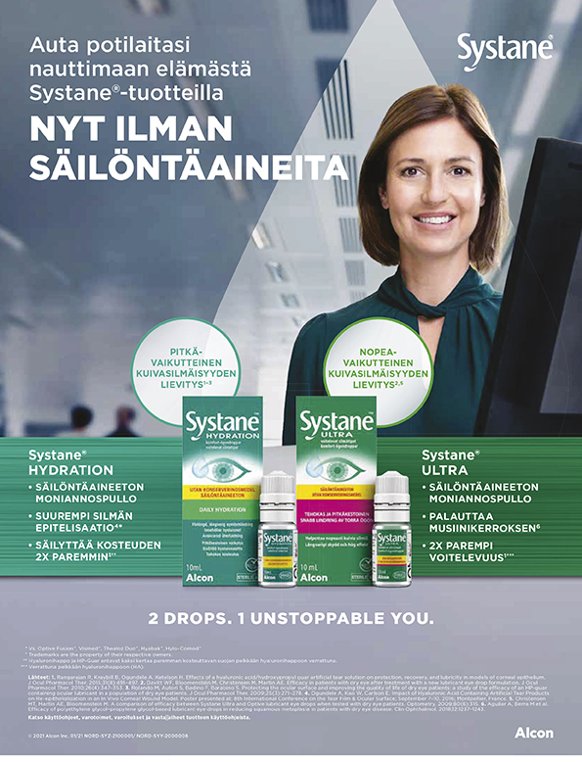
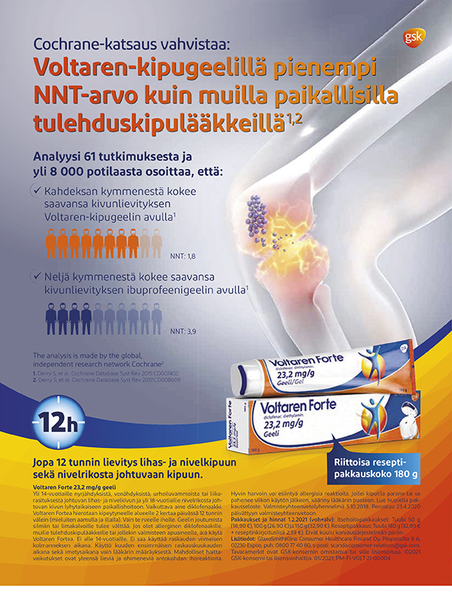
Apteekkari
Noting score
57 %
Noting score
57 %
45 %
rated the ad as the best

Slide 89
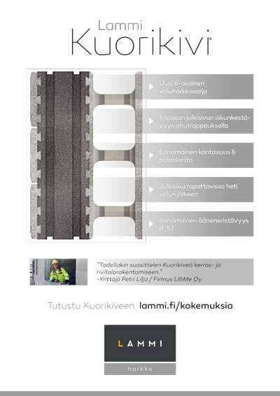
Betoni
Noting score
41 %
43 %
rated the ad as the best

Slide 90


Caravan
Noting score
72 %
39 %
rated the ad as
the best

Slide 91

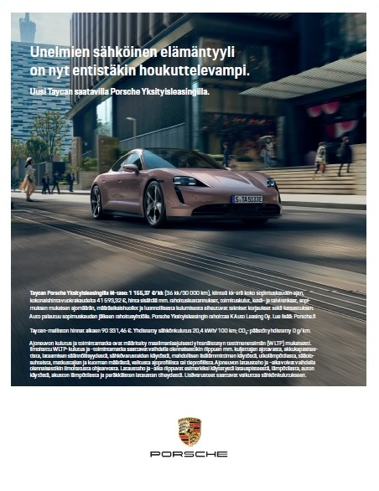
Ekonomi
Noting score
42 %
Noting score
42 %
32 %
rated the ad as
the best

Slide 92
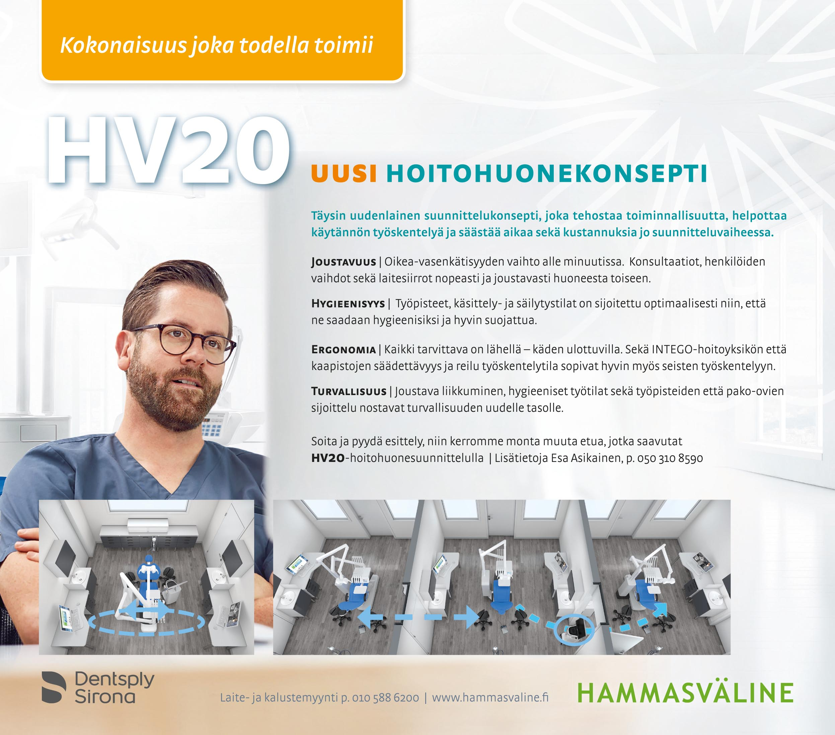
Hammaslääkäri
Noting score
56 %
35 %
rated the ad as
the best

Slide 93
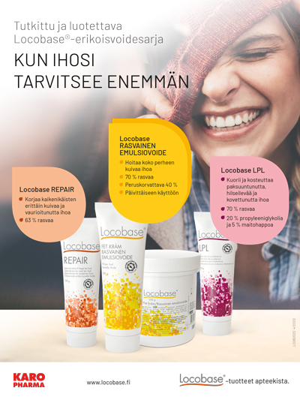
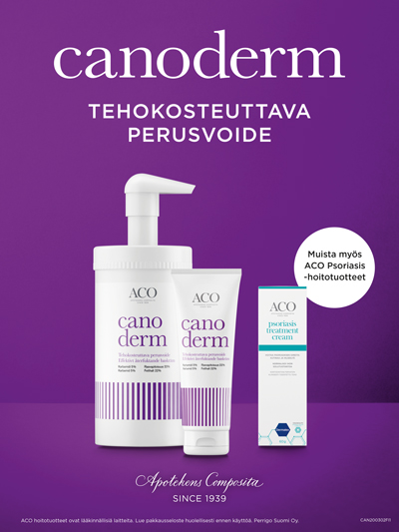
Ihon aika
Noting score
55 %
25 %
rated the ad as
the best

Slide 94
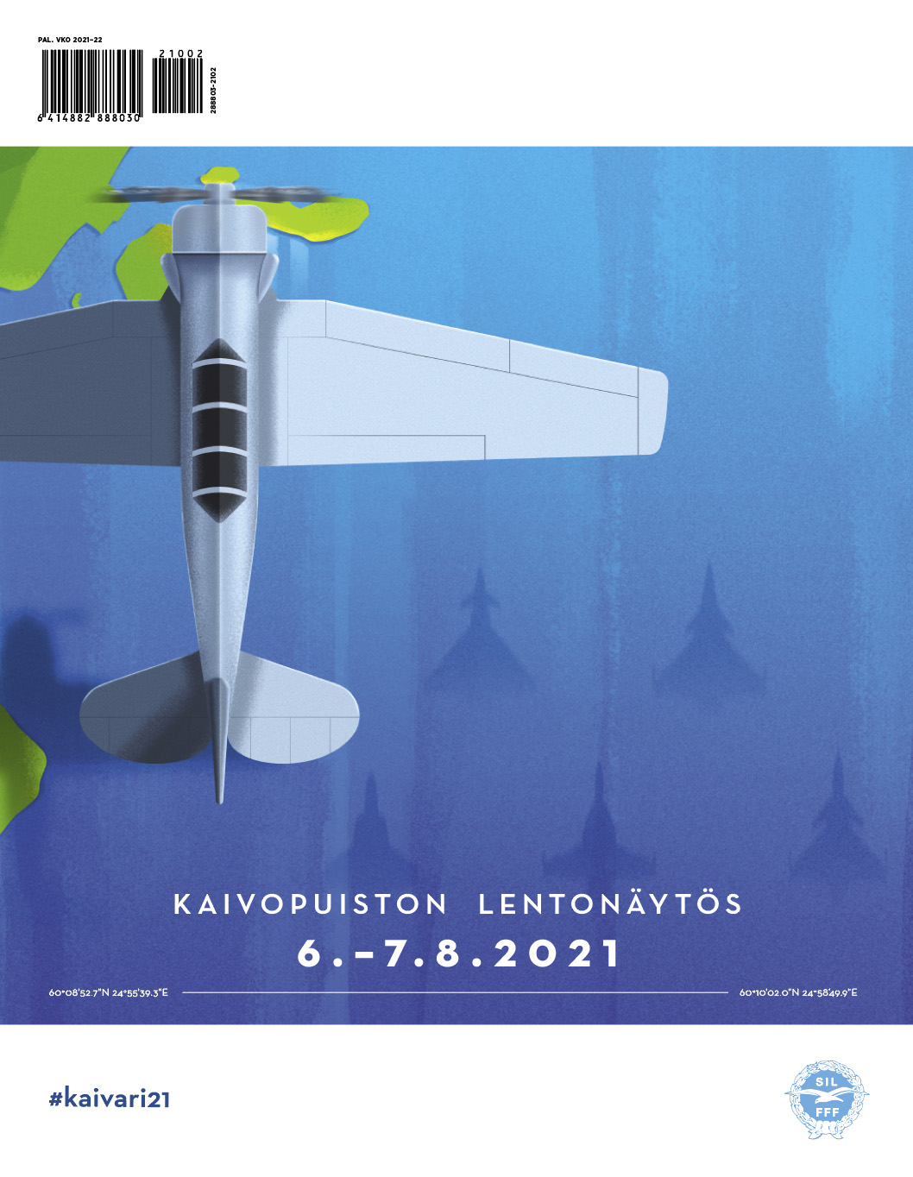
Ilmailu
Noting score
62 %
52 %
rated the ad as
the best

Slide 95
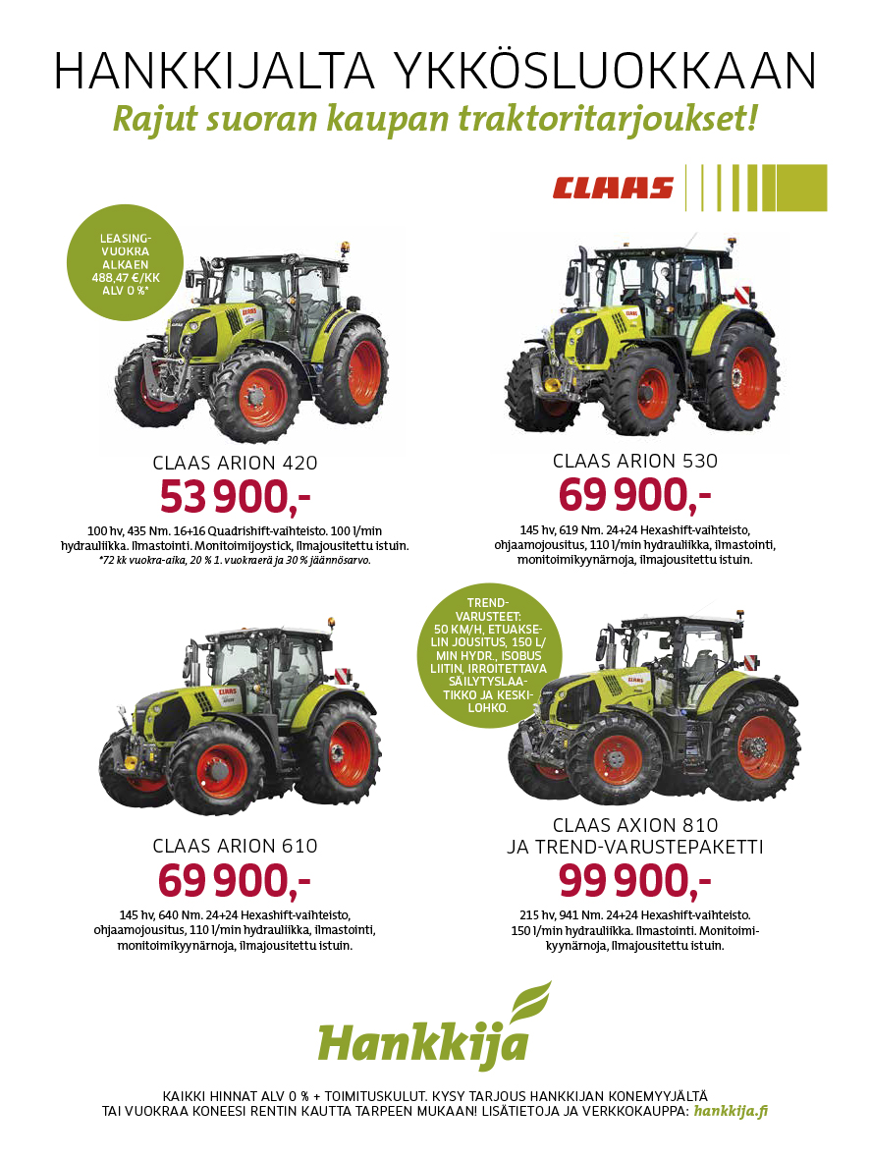
Koneviesti
Noting score
68 %
37 %
rated the ad as the best

Slide 96
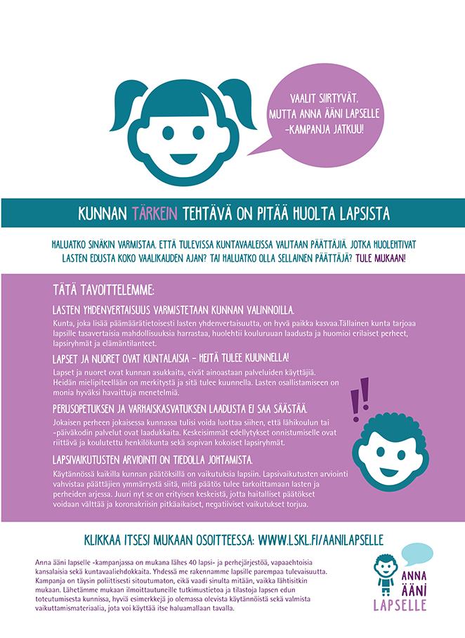
Lapsen Maailma
Noting score
43 %
32 %
rated the ad as
the best

Slide 97
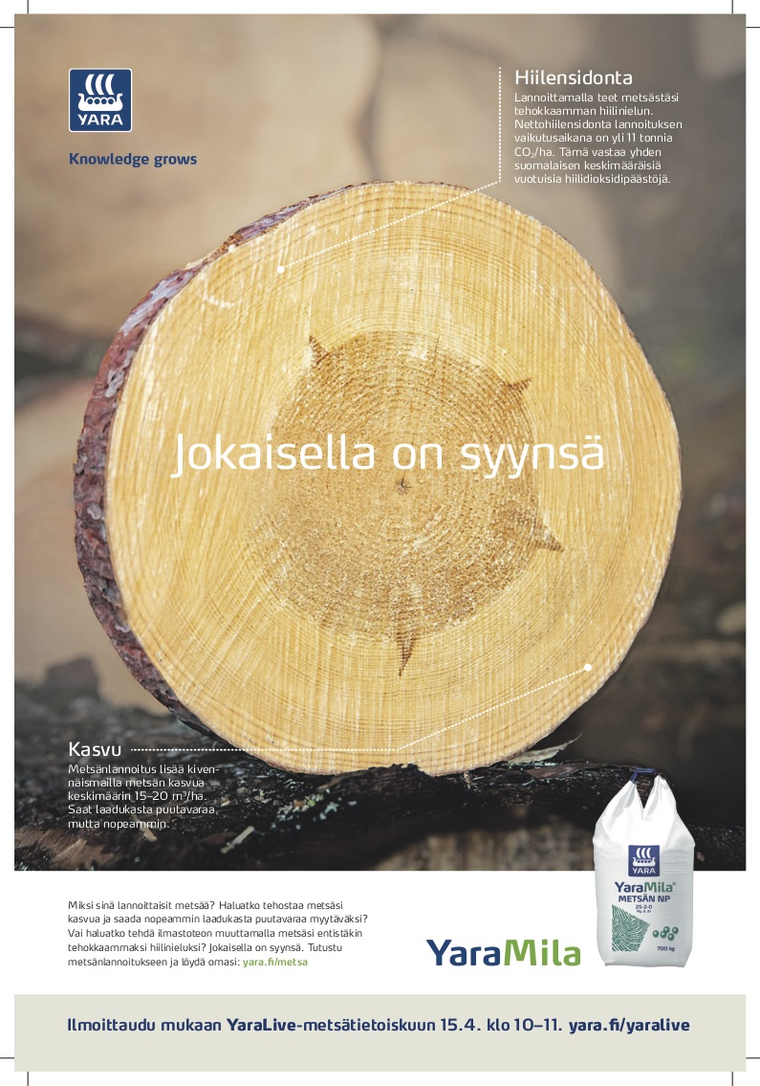
Metsälehti
Noting score
65 %
51 %
rated the ad as
the best

Slide 98
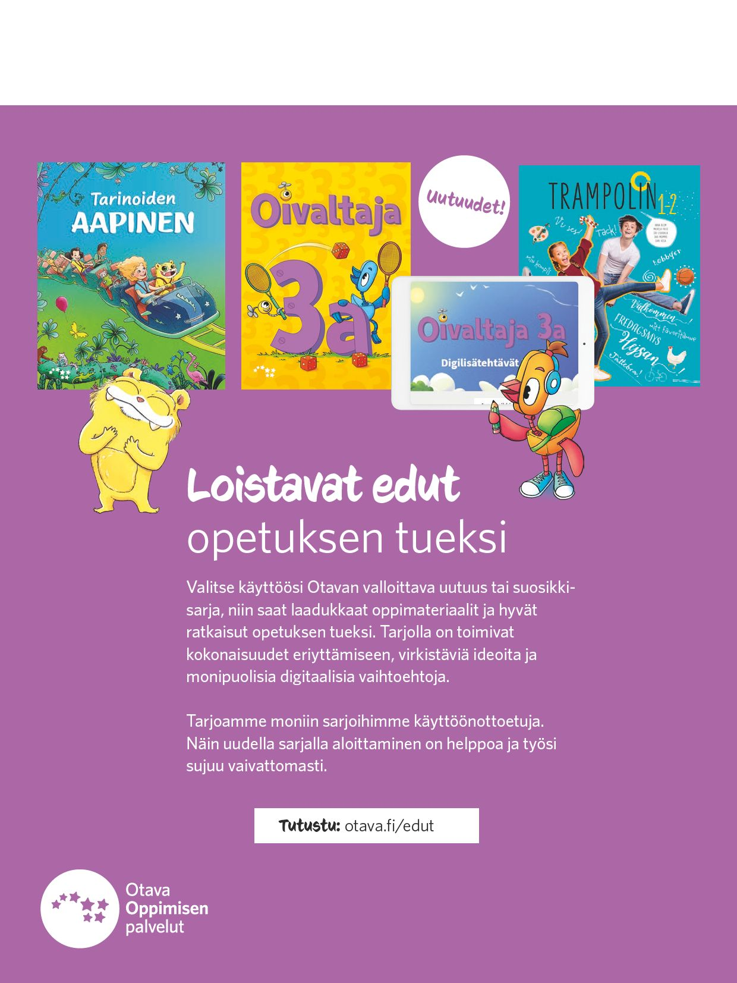
Opettaja
Noting score
37 %
31 %
rated the ad as
the best

Slide 99
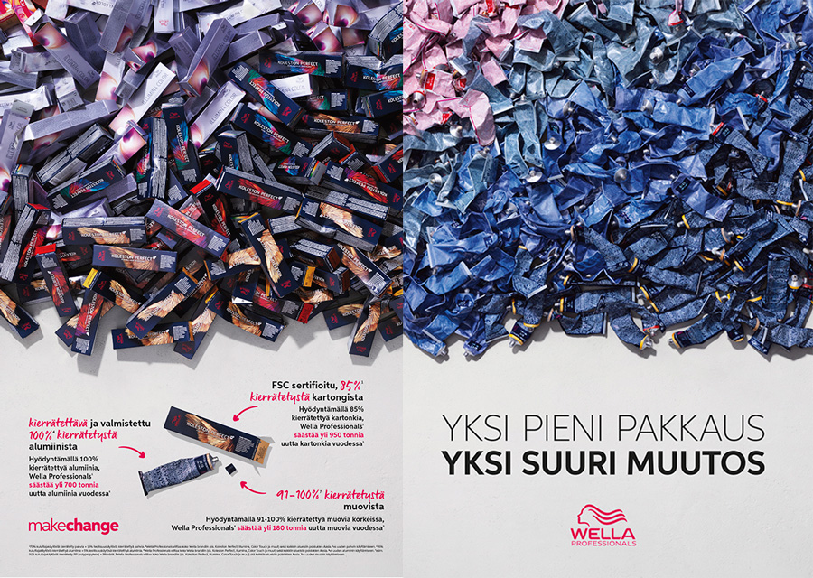
Pinni
Noting score
57 %
51 %
rated the ad as
the best

Slide 100
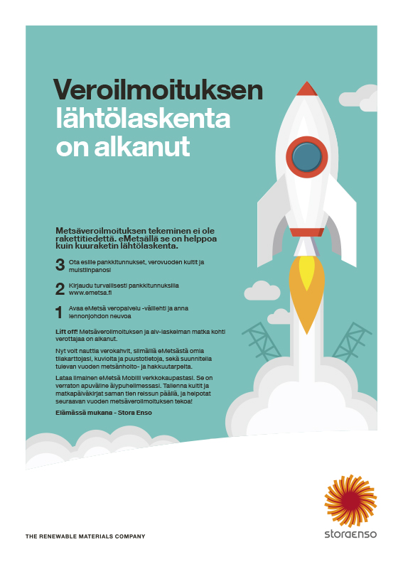
Taloustaito
Noting score
40 %
33 %
rated the ad as
the best

Slide 101
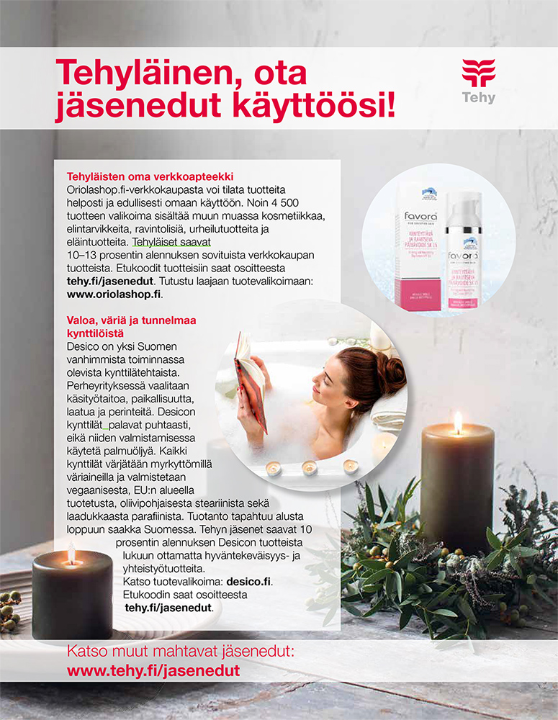
Tehy-lehti
Noting score
45 %
41 %
rated the ad as
the best

Slide 102

Uusiouutiset
Noting score
55 %
43 %
rated the ad as
the best

Slide 103
Advertising summary
The average attention value of the ads was 39%. Attention increases with ad size.
The ads are equally noticeable at the beginning, middle and end of the magazine.
The ads drive people to search for more information online (40%) and increase consideration of purchases (30%).
Almost all of the most notable and best-selected ads are closely related to the topic of the magazine.
The most noticeable and best ad is not always the same (but often yes).

Slide 104
6.
Readers' background information

Slide 105
The respondents are mainly women and men of working age
% of respondents, N = 12,152

Slide 106
Most often, respondents work as experts or white-collar workers
% of respondents, N = 12,152

Slide 107
38 % participate in the company's procurement decisions
I am responsible for company procurement decisions at my workplace | % of respondents, N = 7 755
(Asked readers of 12 magazines)

Slide 108
Readers are highly educated
% of respondents, N = 12,152

Slide 109
Respondents live mainly in large cities
% of respondents, N = 12,152

Slide 110
68 % live in an adult household
% of respondents, N = 12,152

Slide 111
Well-off - 37% of respondents’ annual gross household income exceeds € 75,000
% of respondents, N = 12,152

Slide 112
7.
Summary

Slide 113
Summary
Commitment to professional and organization magazines is high - they are read regularly and readership periods are long-term.
COVID-19 has increased reading.
A professional or organization magazine is an important source of information about an industry, interest area, or organization — it is unique, provides peer support, keeps you up to date, engages newcomers, helps maintain professional skills, provides inspiration, and compiles the essentials in an easy-to-use format.
Satisfaction with the content of your magazine is high.
The ads are equally noticeable at the beginning, end and middle of the magazine. The best ads are related to the topic of the magazine.
Readers are well-off, adult, educated city dwellers.

Slide 114
Thank you!
Outi Itävuo
Aikakausmedia
outi.itavuo@aikakausmedia.fi

